Slide 1
UTSA CS 4593: CS-CURE
Course-based Undergraduate Research Experience in CS
Amanda Fernandez, Ph.D
UTSA Department of Computer Science
Spring 2024

Slide 2
UTSA CS-CURE
End of semester
Research Poster Presentations: 4/30 & 5/2
There will be a short activity worksheet on the day you are not presenting.
Research Paper Final Submission: 5/2
Quiz 2 / Survey 2: 5/2
Final Exam: Thursday 5/9 11am-12:50pm

Slide 3
UTSA CS-CURE
End of semester
2 surveys need your attention, please!
Course Evaluations
From UTSA on Canvas.
Feedback on the course & instructor.
Helps the university evaluate courses & the results are shared to Bluebook.
Due 5/2
Survey #2
From me on Canvas > Assignments.
Optional survey not connected with course grading.
Gives me feedback on whether this course should be offered again in the future.
Due 5/2

Slide 4
Week 15:
Next Steps in Your Research
+
Research @ UTSA VAIL

Slide 5
UTSA CS-CURE
REMINDER
Next week we meet in the North Paseo Building!
(Do not come to BB 3.03.24)
Week 15
Tuesday:
Next steps in your research journey
Research presentation: Dr. Amanda Fernandez - UTSA Vision & AI Lab
Thursday:
Project Clinic - no activity or lecture, just bring any questions you have about your research project, your instructor will be in class to help.
Deliverables:
None! Get ready for your poster session next week!

Slide 6
UTSA CS-CURE
Week 15
Congratulations! We’re almost at the end of the semester!
Believe it or not, you’ve completed the hard part of the research process -
identifying a problem of interest
understanding the landscape of solutions
proposing experiments, data analysis, and other relevant evaluations

Slide 7
Next Steps in Your Research Journey
After CS-CURE
Now it’s time to execute the research (if you’re still interested, after this semester).
Identify resources - Who can you work with? Need compute power, access to data, or other?
Set a goal - Once you execute your plan, how will you share your findings?

Slide 8
Apply to these today!

Slide 9

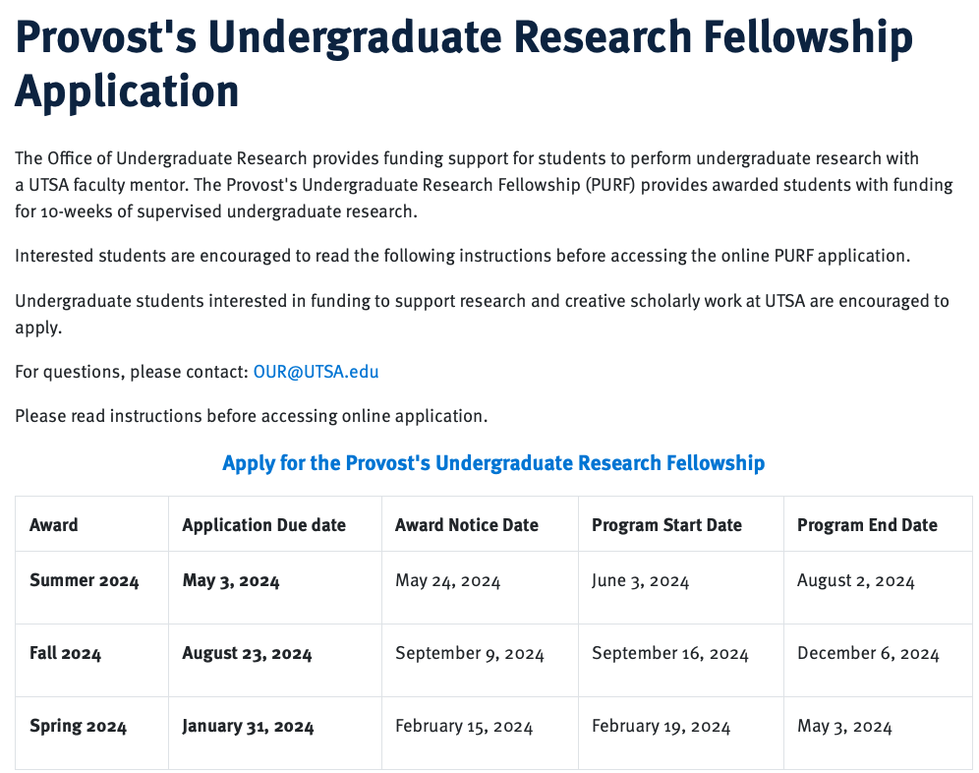
UTSA Office of Undergraduate Research
https://provost.utsa.edu/undergraduate-research/scholarship-application.html
Want to continue your research?
1. Find a faculty in the field.
2. Request their mentorship.
3. Apply by the deadline —>
4. Complete your experience
5. Get paid :)

Slide 10

https://provost.utsa.edu/undergraduate-research/mcnair.html

Slide 11

https://provost.utsa.edu/undergraduate-research/mcnair.html

Slide 12


Slide 13
Next Steps in Your Research Journey
Identifying a Faculty Mentor
Identify your next step - are you looking for a summer REU? Applying to graduate school? Taking an independent study course?
Contact your first choice of PI - have a list of faculty ready and contact them briefly (remember the guidelines for communication!)
Review your research plan with them - meet to discuss your goal and research plan. Be flexible as they recommend changes!

Slide 14
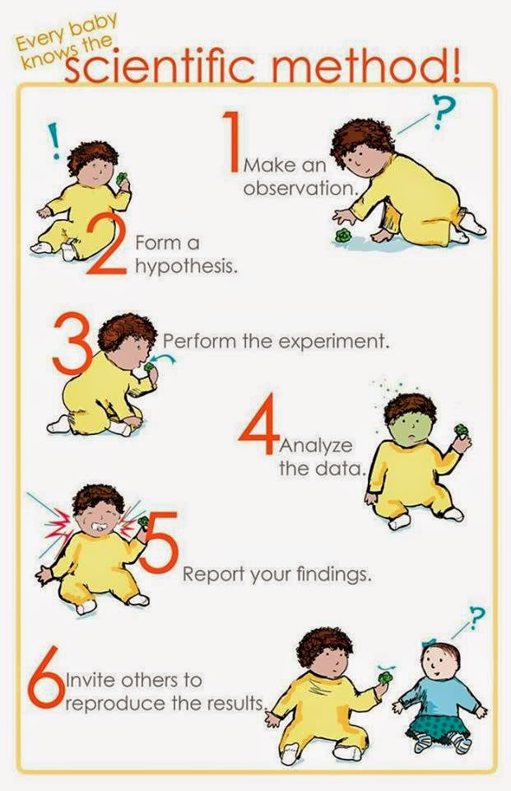
Image source

Slide 15
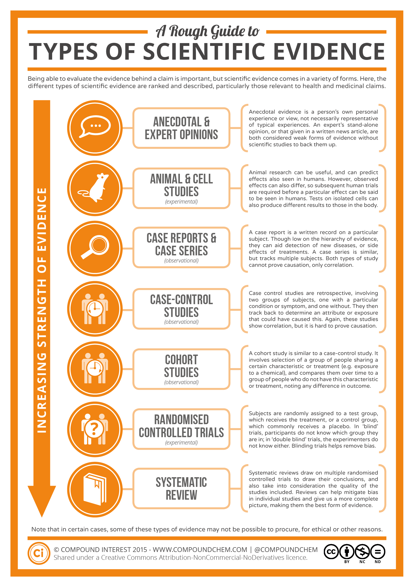
Image source

Slide 16
UTSA CS-CURE
Week 15
Tuesday:
Next steps in your research journey
Research presentation: Dr. Amanda Fernandez - UTSA Vision & AI Lab
Thursday:
Project Clinic - no activity or lecture, just bring any questions you have about your research project, your instructor will be in class to help.
Deliverables:
None! Get ready for your poster session next week!
See you Thursday!

